Slide 1

Tinker, Tailor, Designer, Spy
(UX/UI, Design & Styling)
LESSON 7
CFGDEGREE → FULL-STACK STREAM

Slide 2

AGENDA
01 What is UX / UI
02 Design heuristics (Norman)
03 Information Overload
04 Influences on human attention
05 How spoken language affects design
06 Design heuristics (Nielsen)

Slide 3

Why is design so important?
This deviation from React will pay off!
First, a few definitions. The whole point of development is often to make a product - this is a something that people find valuable and feel that it has generated some value for them.
For example, Facebook is the solution to the frustration of not being able to contact friends across the world
It’s important that the product is intuitive (e.g. unlike a ‘Norman Door’, which we’ll explore next slide) and avoids designer ‘naive psychology’ (believing that we see the world objectively and assuming requirements for the user) in the pursuit of excellent user experience.
To accomplish the above, we need good design for our product! And to ensure that we have good design, we tend to follow guidelines set out design principles and heuristics (to explore shortly)
“Good design is actually a lot harder to notice than poor design, in part because good designs fit our needs so well that the design is invisible”
Donald A. Norman, The Design of Everyday Things

Slide 4
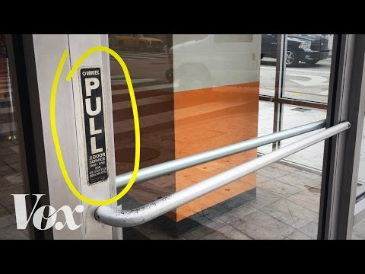
How design matters in everyday stuff
And how this showcases why a good product is needed!
(If link doesn’t work) - https://www.youtube.com/watch?v=yY96hTb8WgI

Slide 5
Design Principles / Heuristics (Norman)
Now that you’ve seen the importance of design, we can see how to achieve it
Norman proposes 7 principles to follow:
Use both the knowledge in the world and in the head: Make use of what the user already knows to reduce their mental load!
Make it natural! We’ll explore this later, but think something like language; english readers scan left to right, but arabic readers may scan right to left instead (the language is right-to-left instead!)
Simplify the structure of the task: Ensure that the structure is simple - for example, cut down on the number of steps something may have
Make things visible: Ensure that components or function that a user will need is visible - otherwise, the user has to spend time looking (annoying) and may not know what to do next
But make visible only the stuff that matters. For example, on a log-in screen, we only need logging components - anything else is just clutter!
Continued on the next page

Slide 6
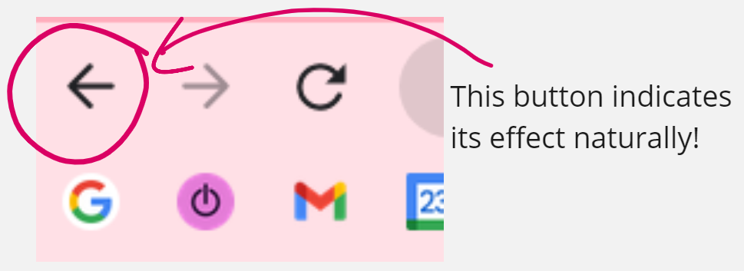
Design Principles / Heuristics (Norman)
(Continued…)
Get the mappings right: Ensure that the effect a component has matches its control (e.g. how a left arrow represents usually movement for going back, a button should similarly match this level of direct mapping)
Exploit the power of constraints, both natural and artificial: Place constraints and arrange components in a way that the user is naturally is guided to them themselves - they don’t have to remember where the back button is this way
For example like how most back buttons are usually located on the top-left of the screen / associated with left (e.g. iOS, swipe left for back. Most back movements have a left-directed button)
Design for error: Assume that users will make an error at some point, and plan accordingly
When all else fails, standardise: Use standard icons, or follow other standard conventions

Slide 7
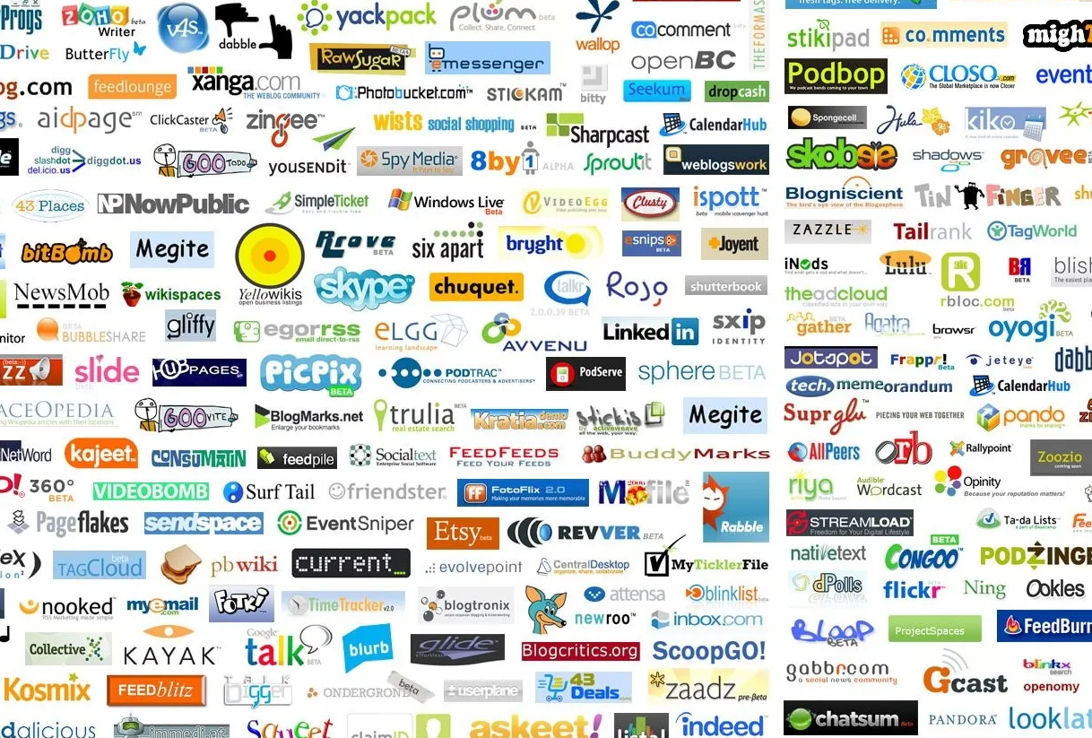
What do these heuristics help us avoid?
What’s the actual effect of good design, what do we actually avoid
Information overload - instances where so much information is presented that the user is left confused or paralysed with making a decision
Originally coined by Professor Bertram Gross, he argued that decision makers have limited cognitive capacity and that information overload can lead to worse decisions. Even in the best case scenario (of no confusion or lack of decision), we’re still likely to make a bad decision instead.
By the time you read this and have checked the image, think - can you remember more than 2 company names?
# INFO OVERLOAD

Slide 8
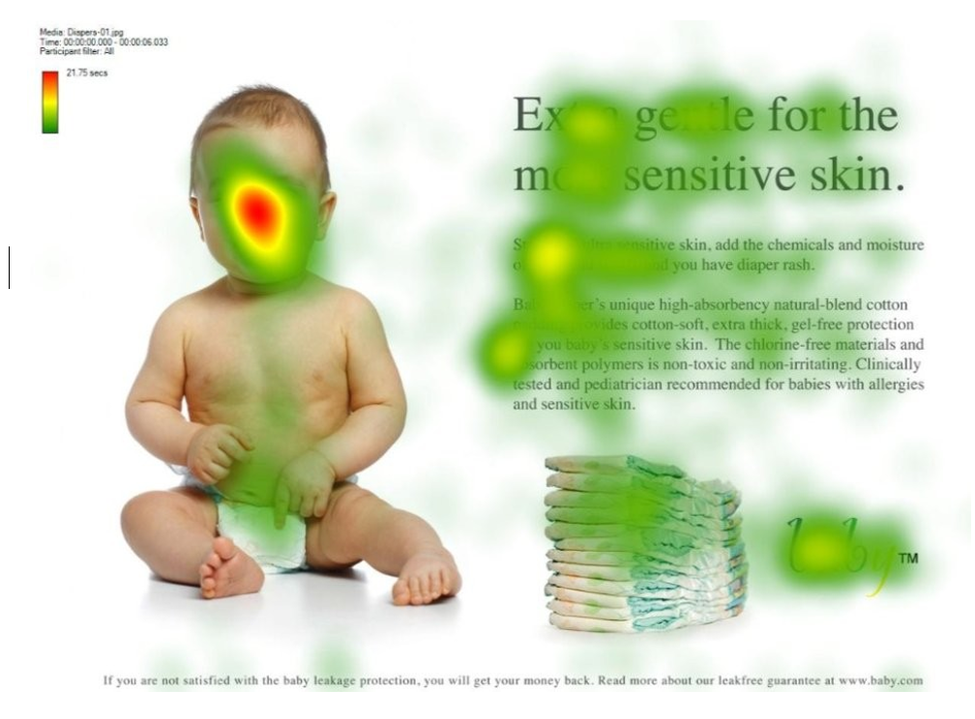
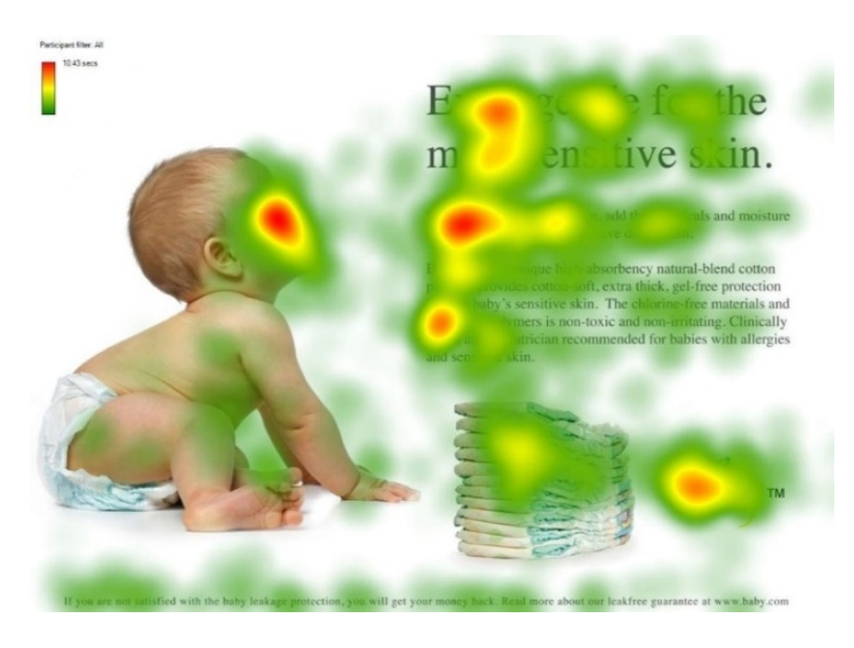
What do these heuristics help complement?
Not only can we avoid info. overload, we can only benefit too! (1 of 2)
For one, they can allow us to unconsciously direct the user throughout the website without them even realising it.
Consider the right-hand side example; eye tracking research indicates that having a directed gaze at an area of the website (via some character) makes users unconsciously prioritise that area more.
Have you ever gone onto a website and felt like you could navigate it easily? That’s good design - it’s oriented around almost doing it itself (and you’re simply in it for the ride!).
From “You look where they look” by James Breeze

Slide 9
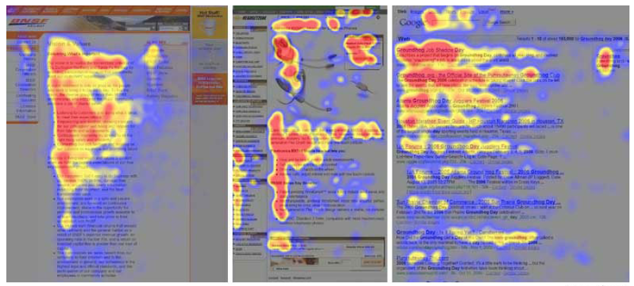
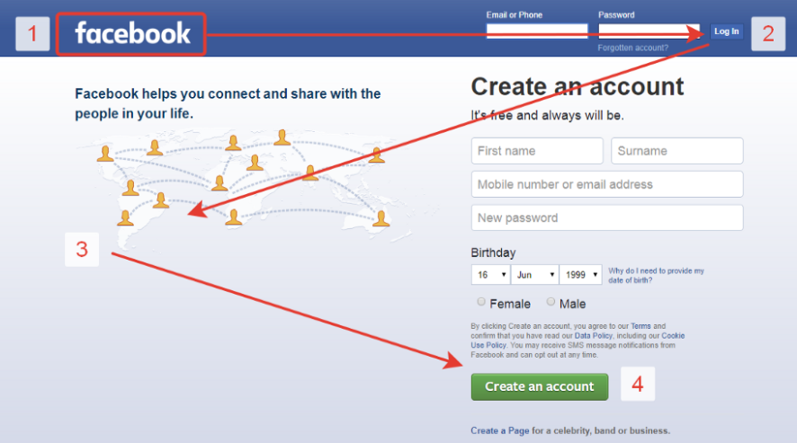
What do these heuristics help complement?
Not only can we avoid info. overload, we can only benefit too! (2 of 2)
For two, they help us design in-line with how people unconsciously scan websites.
Note that many people will scan websites in a F or Z-pattern, which is why most websites are structured in that pattern!
This is likely due:
It’s simply more efficient - there are a million alternatives to that current screen + reading from a screen is tiring
Information foraging theory - like animals, we forage right now for information instead and can do it faster this way
F Example
Z Example

Slide 10
Eye scanning patterns continued
In the land of people with sight, the pattern-informed designer is king!
This type of scanning approach may be evolutionary based - try this example exercise:
Without moving your neck, look around your surroundings for a few seconds (just move your eyes around)
Now hold up a finger and track it with your eyes (don’t move the neck like before) while you move it for a few seconds
You may have noticed that your eyes jump in the first instance and roll slowly in the second instance! This comes from a evolutionary tactic where you’d scan surroundings quickly (hence the eyes jump, to maximise what is seen at the cost of detail) or alternatively track something (maximise detail by only focusing on one thing).
Understanding human behaviour like this allows us to anticipate actions when designing websites - knowledge from the HCI (human-computer interaction) field allows us to optimise our websites to be used to the best of its potential!
Hence, it’s incredibly important that we design and position our components carefully to make the best use of this all. One more note on the eye scanning pattern:
It is language-dependent; we’ll see an example on this on the next slide

Slide 11
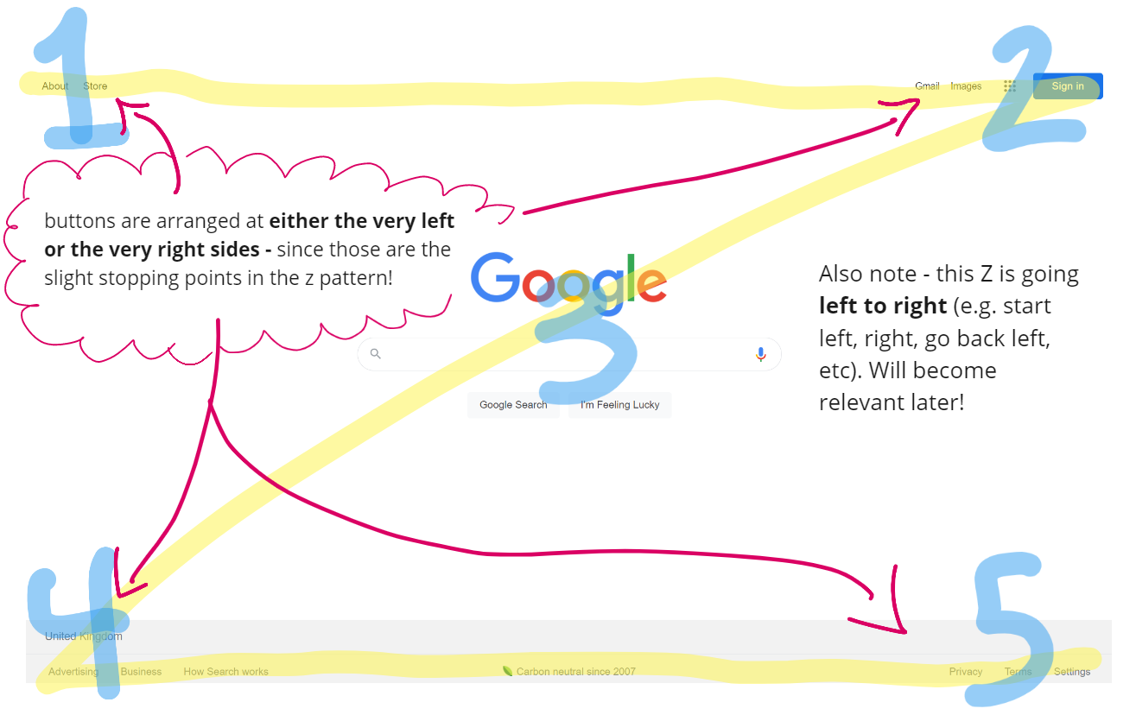
Language effects on scanning sites
Analysing Google in English & Farsi / Persian
As you can see, Google’s website is arranged in the same Z pattern
The main part of Google, the actual search bar, is centered exactly in the middle - an immediate catch when scanning everything / stands out
This slightly changes in different languages

Slide 12
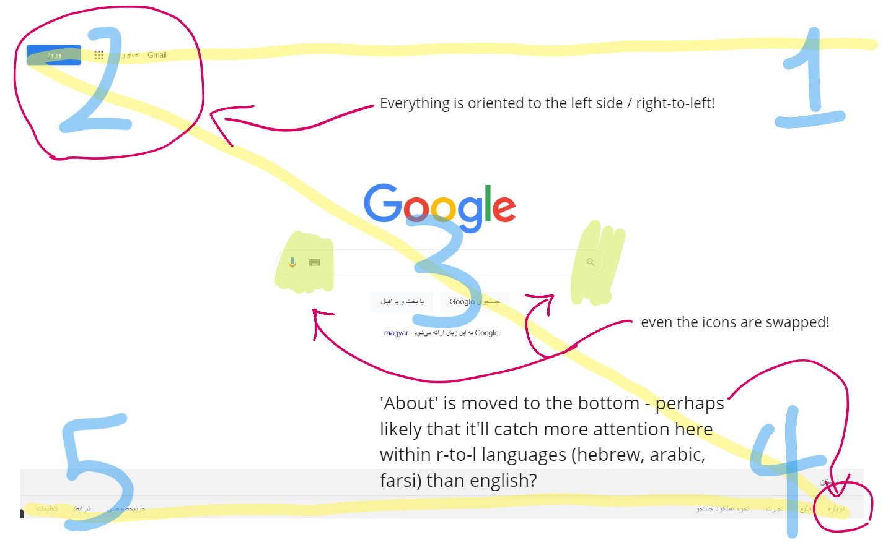
Language effects on scanning sites
Analysing Google in English & Farsi / Persian
The website arrangement completely changes when the language is one of right-to-left!
Curiously you don’t see this effect with other left-to-right languages like German or Spanish; the format remains the same.
Hence, be mindful of the way the user parses due to their language! You may need to rearrange components based on it!

Slide 13
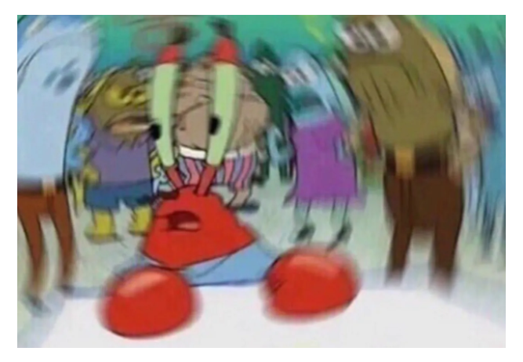
Design Principles / Heuristics (Nielsen)
Aside from Donald A. Norman, there were other people who proposed their heuristics too!
Feel free to make equal use of Nielsen’s 10 general design principle:
Visibility of system status: Users should be aware of what’s going on at all times to prevent them feeling lost. Your user shouldn’t feel like this!
Match between the system and the real world: Speak what the user already knows - discard jargon and make use of languages / actions the user is already familiar with from the real world.
User control and freedom: Users may make mistakes. Give them the ability to navigate elsewhere or have the freedom to escape - in essence, maximise the control a user has.
Consistency and standards: Do not differ - follow industry conventions. Jakob’s Law argues that people spend most of their time on other websites, so follow what already exists so that users don’t feel confused by something entirely new.
Error prevention: Account for human errors or unexpected situations, and place safeguards. (Ctd. next slide)

Slide 14
Design Principles / Heuristics (Nielsen)
Aside from Donald A. Norman, there were other people who proposed their heuristics too!
Continued from the last slide…
Recognition rather than recall: Minimise memory load by making components easily usable and familiar (e.g. no need to remember anything)
Flexibility and efficiency of use: Experienced users should have the ability to speed up interaction (e.g. ‘Skip’ button!).
Aesthetic and minimalist design: All pieces of information compete for the users attention. Minimise pieces shown to prevent information overloads or clashes.
Help users recognise, diagnose and recover from errors: When errors are shown, abstract the message to a degree that it’s easy for a user to recover (make it a easy-to-understand error message that tells the user how to fix the issue / what to do next).
Help and documentation: Systems shouldn’t ordinarily need additional explanation, but in cases they do there should be some documentation available to help the users gain understanding (e.g. like an information kiosk).

Slide 15
SUMMARY
Design is in everything around us - it determines a good product from a bad one, a good door from a bad one, and it can influence us invisibly.
Heuristics and principles are guidelines we can look to for ensuring that our designs are effective
If there’s spare time, work on your projects! Using what we’ve discussed, think about what you can change in your project / modify / create a new one / etc!

Slide 16
THANK YOU!

